Slide 1

2026 – 2027 Budget

Slide 2
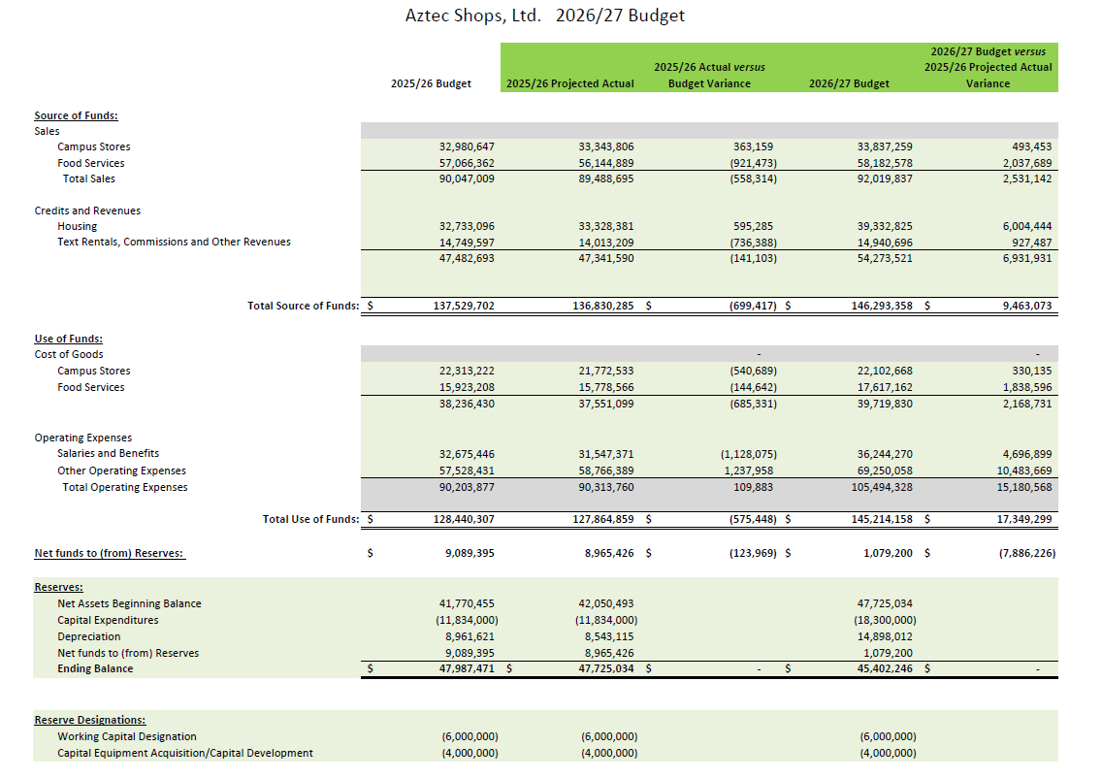
Budget Summary

Slide 3
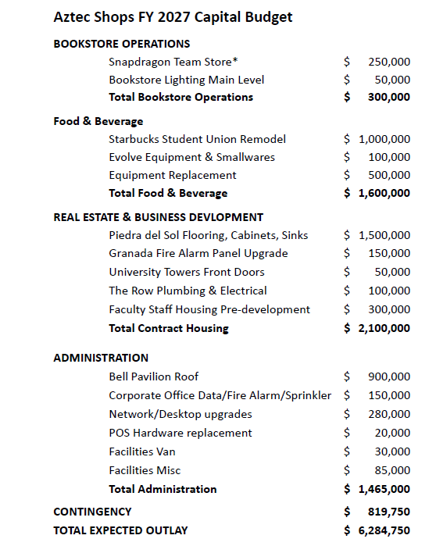
Capital Budget

